Slide 1
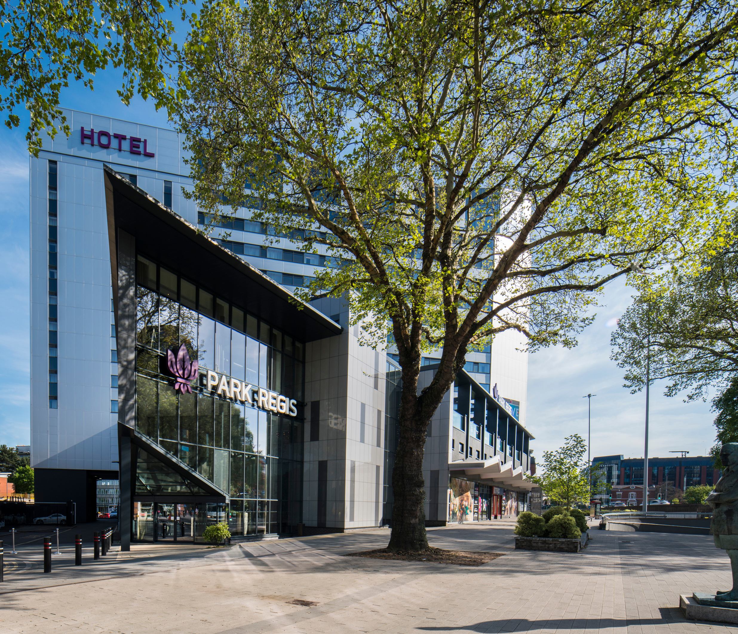



WELCOME TO YOUR ECO-FRIENDLY STAY
  Updated August 2026

Slide 2
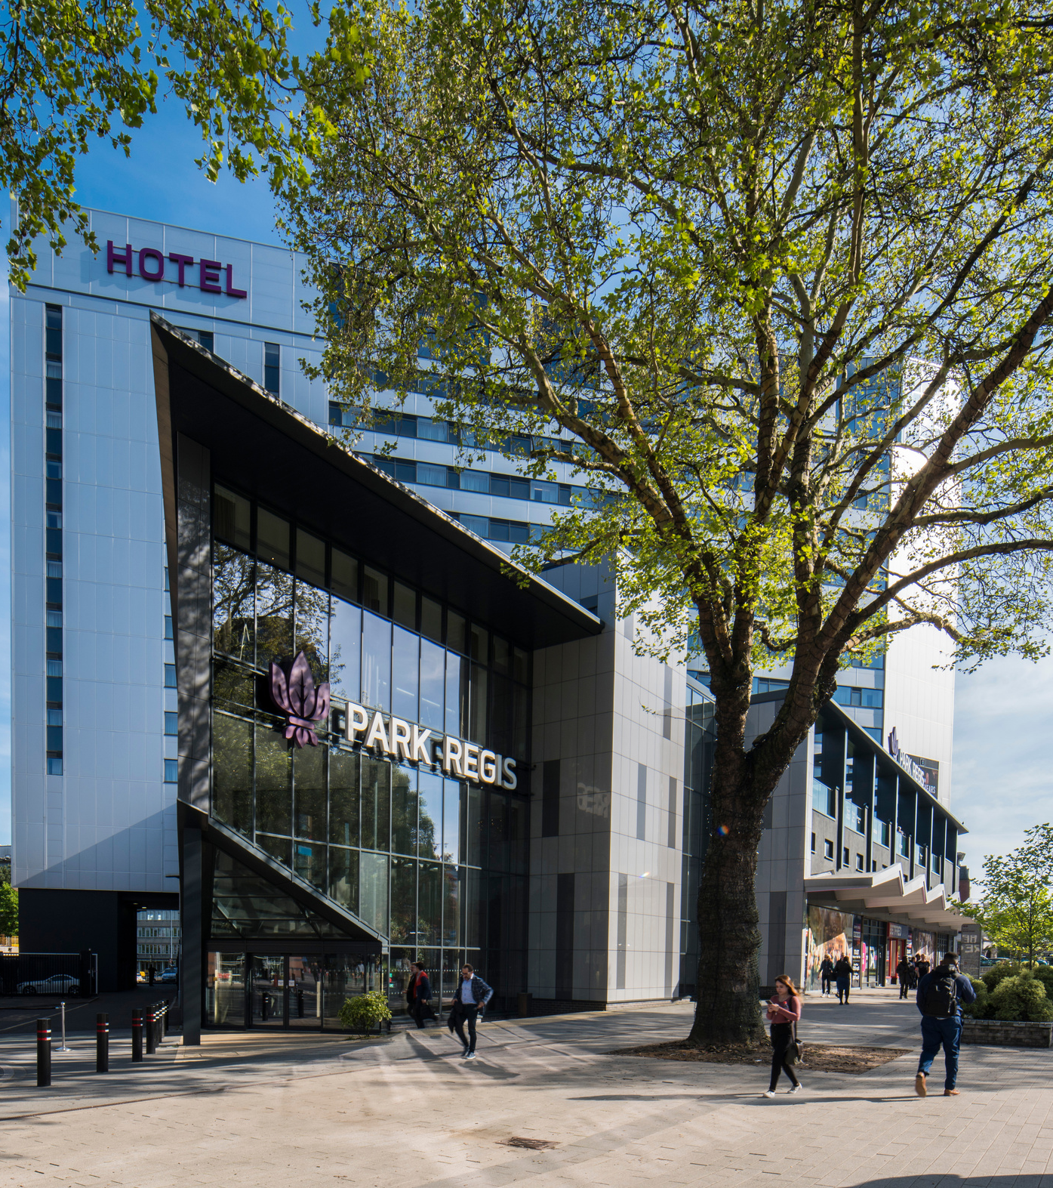
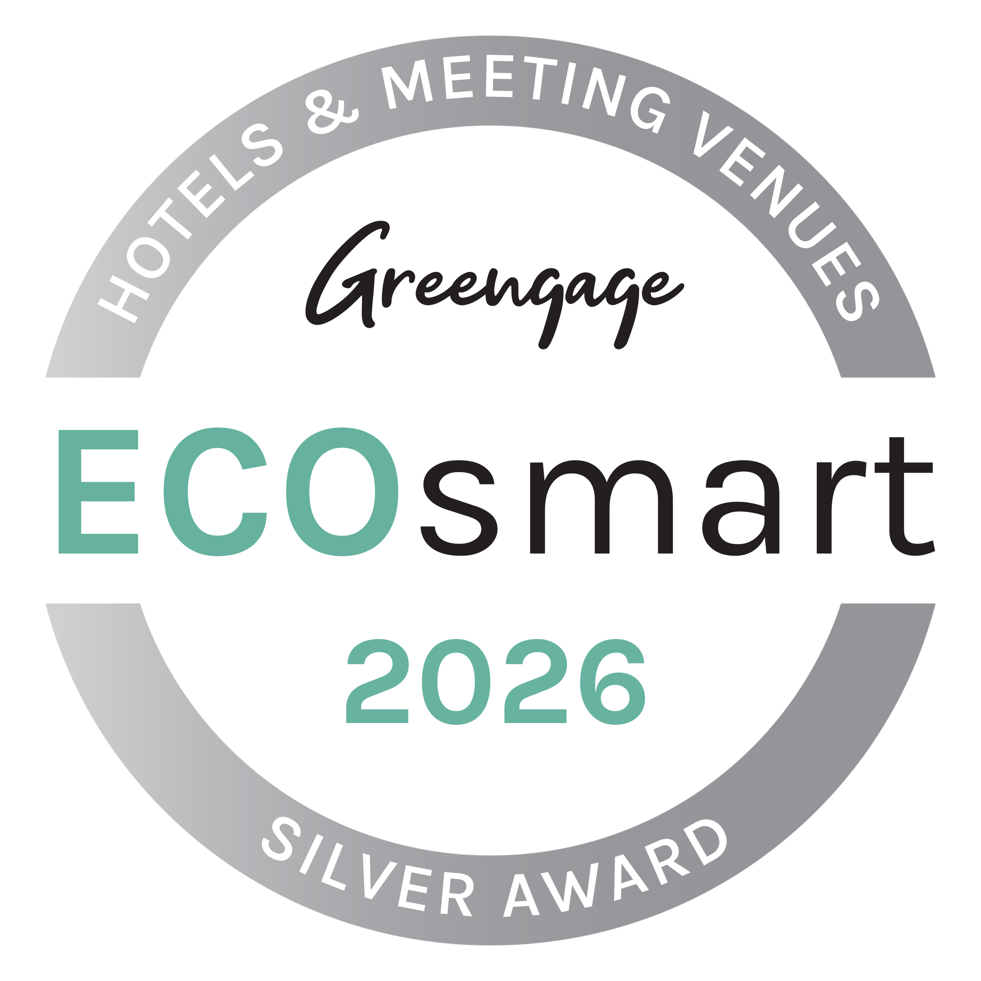
introducing
PARK REGIS BIRMINGHAM
Everything from energy/waste management, sustainable purchasing, to the toiletries in our guest rooms, we have honed in on every element of the hotel to challenge how we can be more environmentally sustainable by exploring new avenues to improve our practices.
Did you know? We have been awarded the Greengage 2026 ECOsmart Silver award for our efforts towards sustainability!

Slide 3
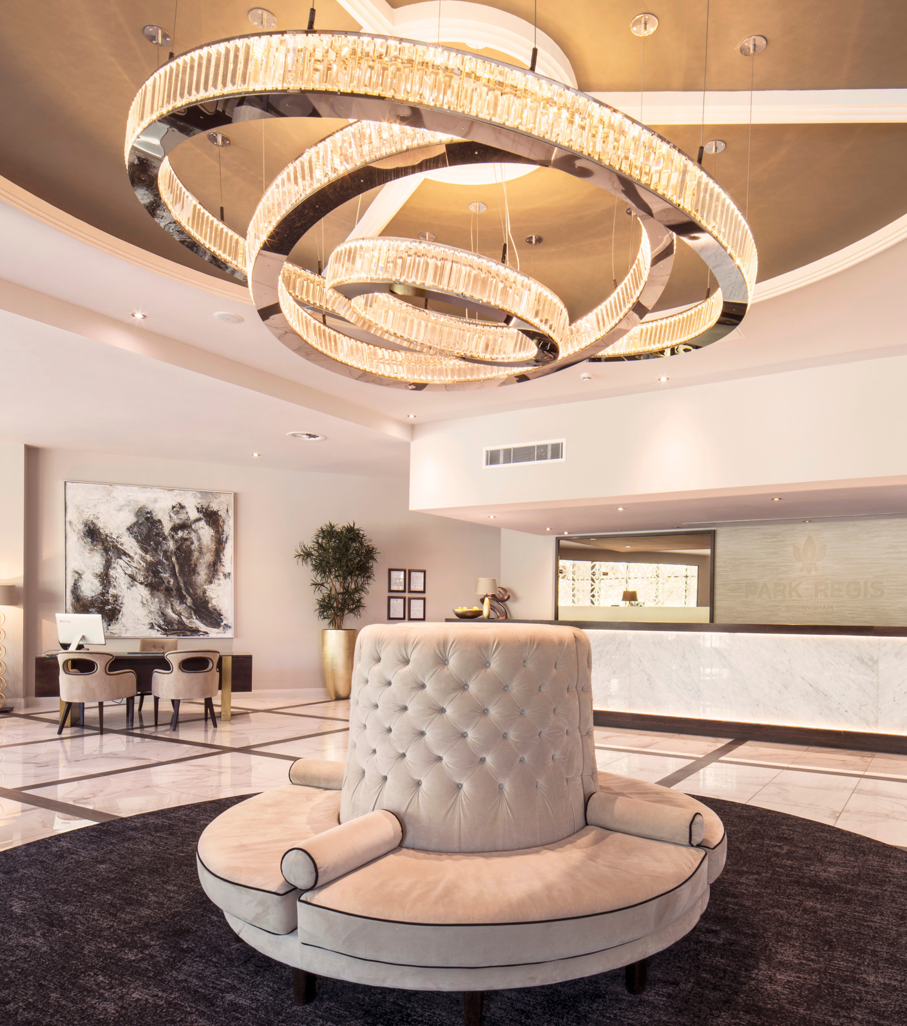
OUR COMMITMENT TO BECOME AN ECO-FRIENDLY HOTEL
  01
  Building management system on site to control and manage our energy usage 24 hours a day.
  02
  Sensor-controlled LED lighting is used throughout the building which uses less energy.
  03
  Bamboo key cards rather than plastic ones.
  04
  Sustainability committee in place.
  05
  Awarded the Greengage 2026 ECOsmart Silver award.
  06
  We aim to recycle 40% of all our waste. We recycle plastic, glass paper and food.
  07
  Wooden pencils in our meeting rooms instead of plastic pens.
  08
  Free from single use products, refillable toiletries in all bedrooms and communal areas.
  09
  Our bars have removed all plastic bottled beverages, and have been replaced with glass bottled packaging instead.

Slide 4

EMPLOYEE WELLBEING
Our team is fully trained in Health & Safety, Fire Safety, and Food Hygiene, with a goal to promote 80% of roles internally.
Park Regis is committed to employee wellbeing through clear Employee Commitments, monthly staff committees, and Mental Health Life Training for all managers.
We target less than 1% workplace accidents and partner with Shield Safety Management for expert guidance.
Our HR team is trained in sustainability, and our Green Committee meets monthly to drive eco-friendly initiatives.

Slide 5

LUXURY MEETS SUSTAINABILITY
We’ve switched to eco-friendly toiletries with Rituals, featuring biodegradable ingredients in recyclable, refillable packaging. This change saves 188,652 plastic bottles annually while enhancing guest experiences with high-quality products.
We’ve also replaced plastic room keys, pens, toilet rolls, and tissues with sustainable bamboo alternatives. Why is bamboo more eco-friendly? Bamboo grows 30 times faster than hardwood, needs 30% less water, and releases 35% more oxygen while absorbing 65% more carbon dioxide.
Have you left something at home? We have shower caps, vanity kits, and dental kits made from straw or corn starch, packaged in tree-free stone paper printed with soy ink—offering convenience without harming the planet.

Slide 6
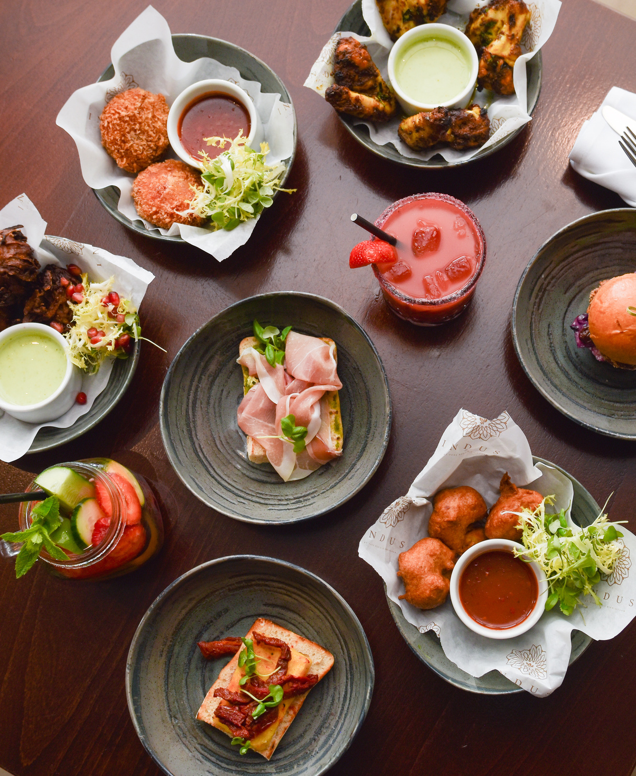
COMBATTING FOOD WASTAGE
In the past year, we partnered with Too Good to Go. Too Good to Go’s mission is to combat food wastage and the detrimental effect this has on the environment.
They work with businesses to sell their surplus food at a reduced price (roughly a third of the original price), which prevents a significant amount of food wastage, daily.
Surplus food is packaged up into ‘surprise’ packages which those who use the app can pre-order, and then can come collect it!
Not only does this help the environment by reducing food waste, but it allows you to try something new from restaurants and cafes at a significantly reduced cost.

Slide 7
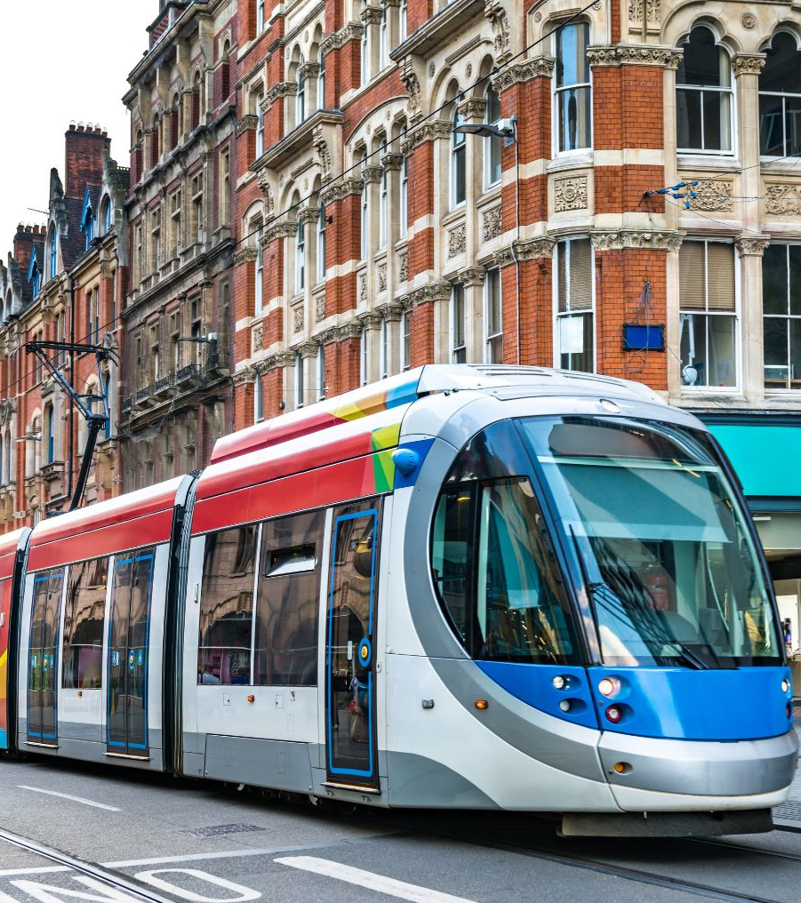
ECO-FRIENDLY TRAVEL
Our city-centre location not only means the best of Birmingham is on your doorstep, but it’s easy to make the most of energy-efficient transport too. Navigating yourself around the city when you stay at Park Regis Birmingham couldn’t be easier!
We encourage our guests to utilise our local transport links i.e., the tram - which is conveniently right on our doorstep.
Five Ways train station is also a 5-minute walk from Park Regis.
We’ll help our guests to find the best way around town, with local walking, cycling and public transport routes.

Slide 8





CONTACT DETAILS
  ADDRESS
  EMAIL US
160 Broad Street
  Birmingham, B15 1DT
  hello@parkregis-birmingham.com
  CALL US
  WEBSITE
  0121 369 5555
  www.parkregisbirmigham.com

